Slide 1
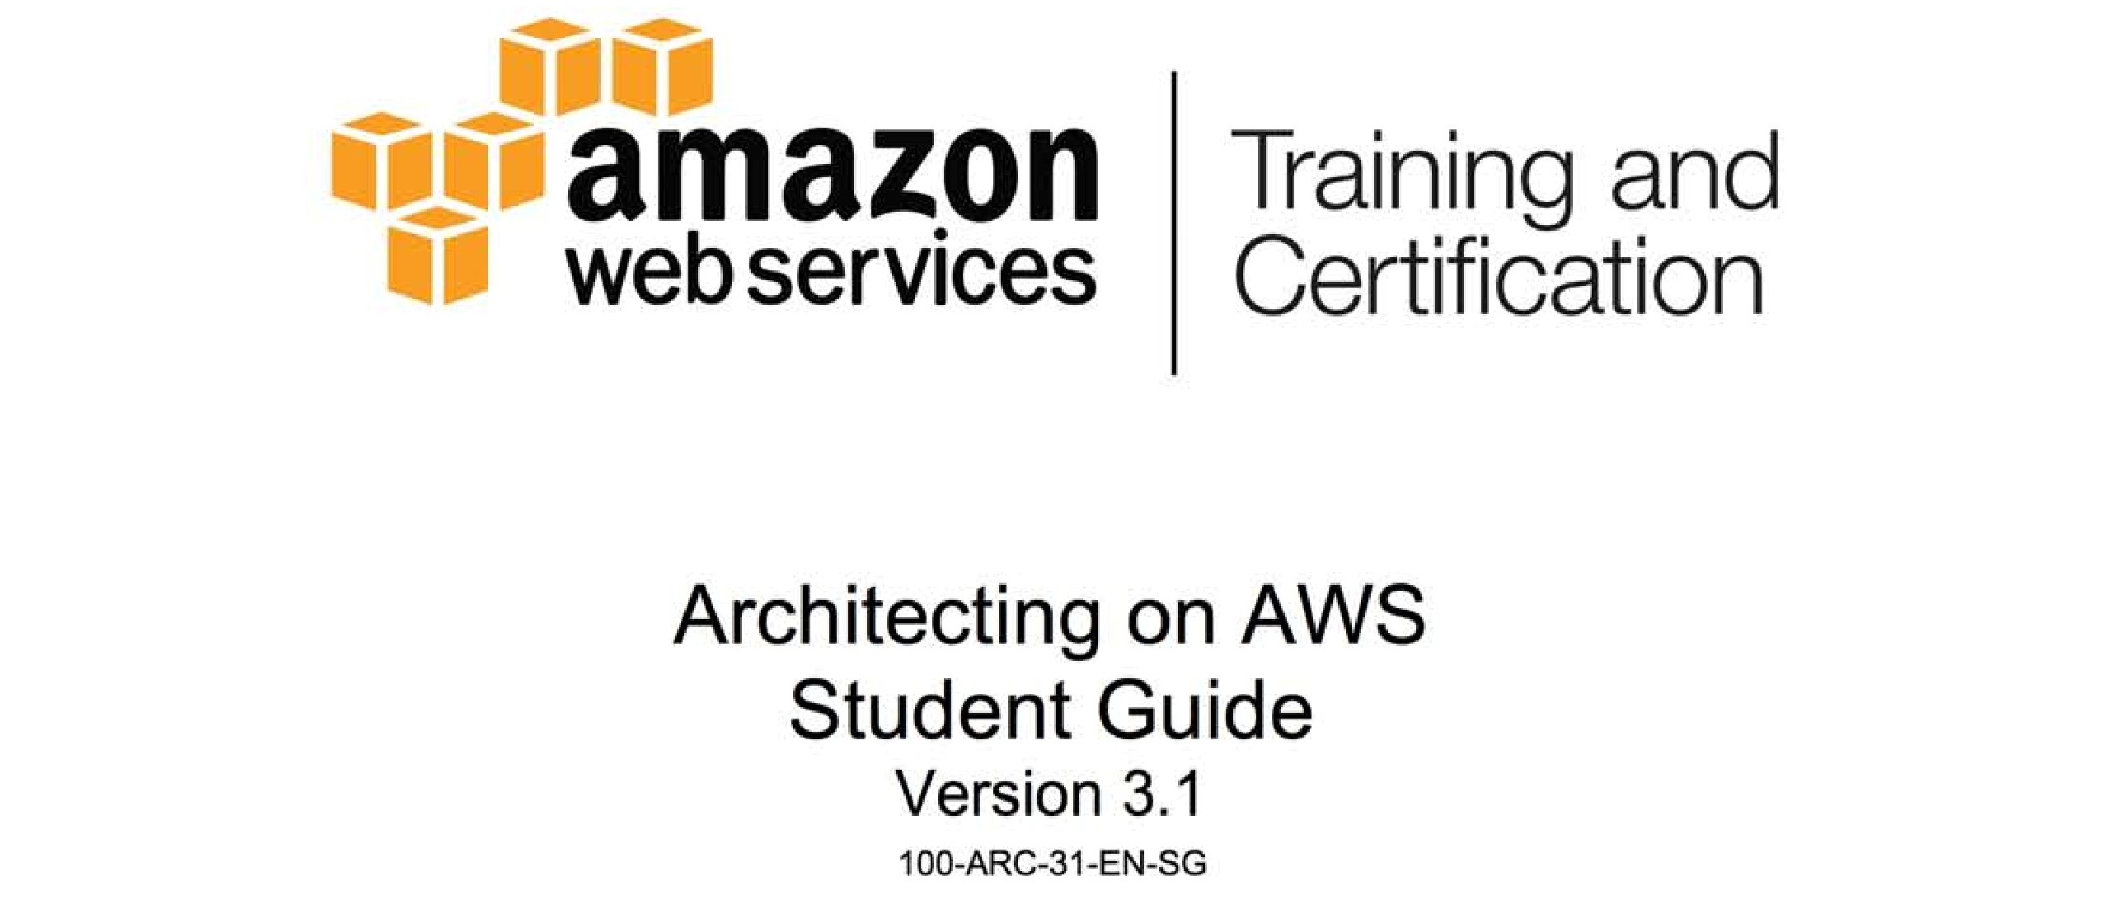

Slide 2

Module 9: Overview of Application Services

Slide 3
Topics
AWS application services
Roles of application services in AWS architecture
Amazon Simple Queue Service (SQS)
Amazon Simple Notification Service (SNS)
Amazon Simple Workflow Service (SWF)
Amazon Simple Email Service (SES)
Amazon CloudSearch

Slide 4
Topics
AWS application services
Roles of application services in AWS architecture
Amazon Simple Queue Service (SQS)
Amazon Simple Notification Service (SNS)
Amazon Simple Workflow Service (SWF)
Amazon Simple Email Service (SES)
Amazon CloudSearch

Slide 5
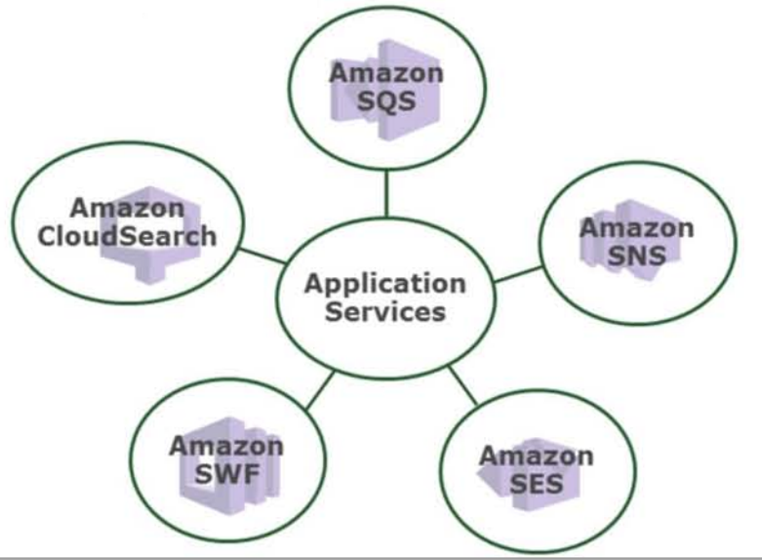
AWS Application Services

Slide 6
Topics
AWS application services
Roles of application services in AWS architecture
Amazon Simple Queue Service (SQS)
Amazon Simple Notification Service (SNS)
Amazon Simple Workflow Service (SWF)
Amazon Simple Email Service (SES)
Amazon CloudSearch

Slide 7

Amazon Simple Queue Service (SQS)
Hosted queue for storing messages as they travel between computers or processes
Move data between distributed components of their applications

Slide 8
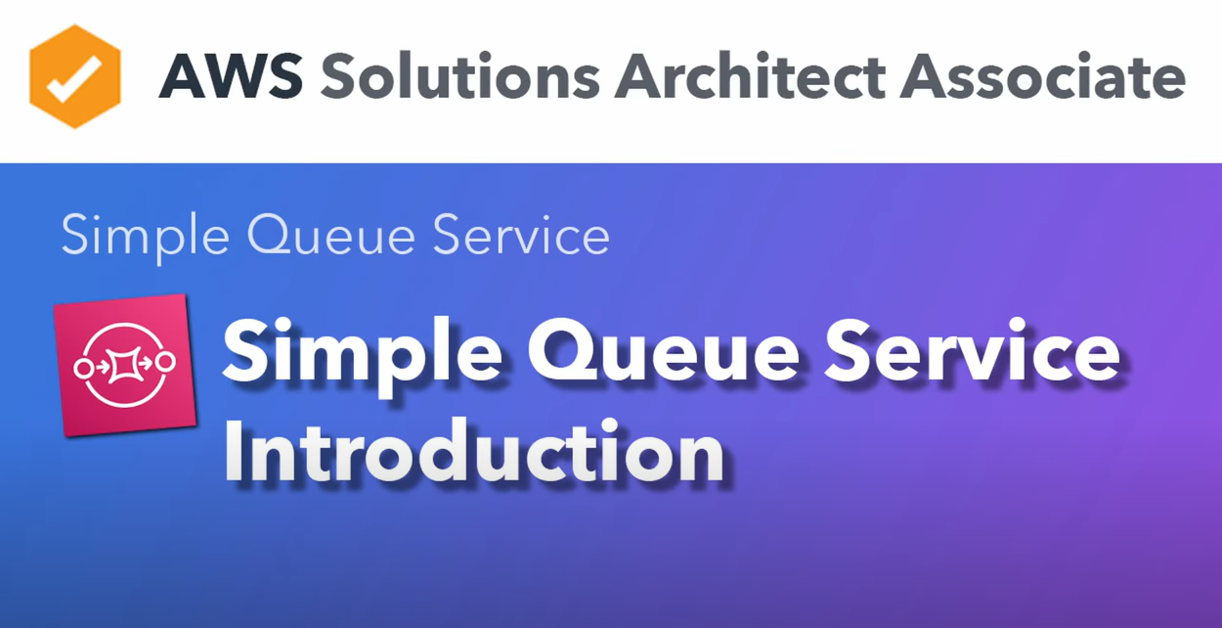

Slide 9
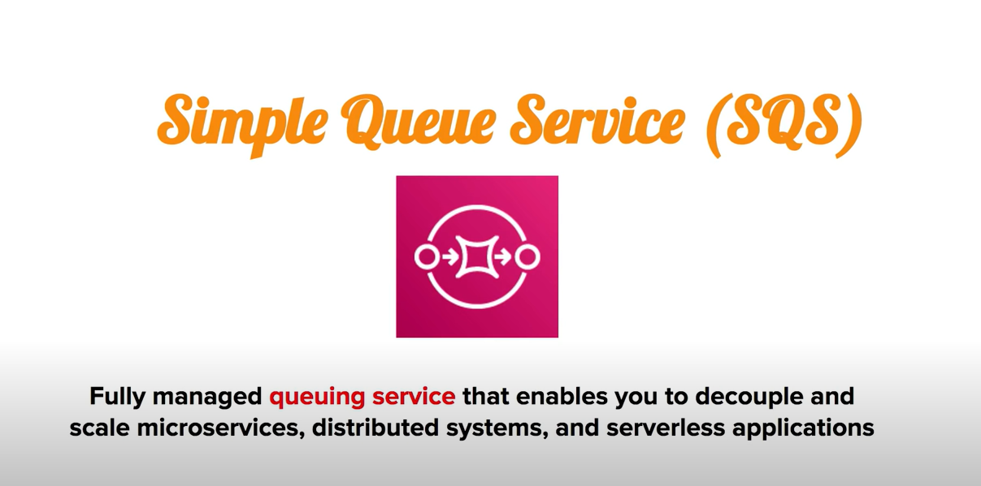

Slide 10
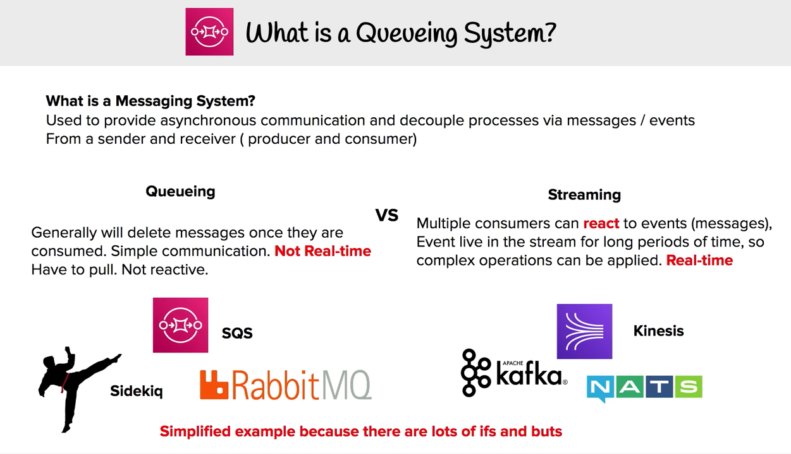

Slide 11
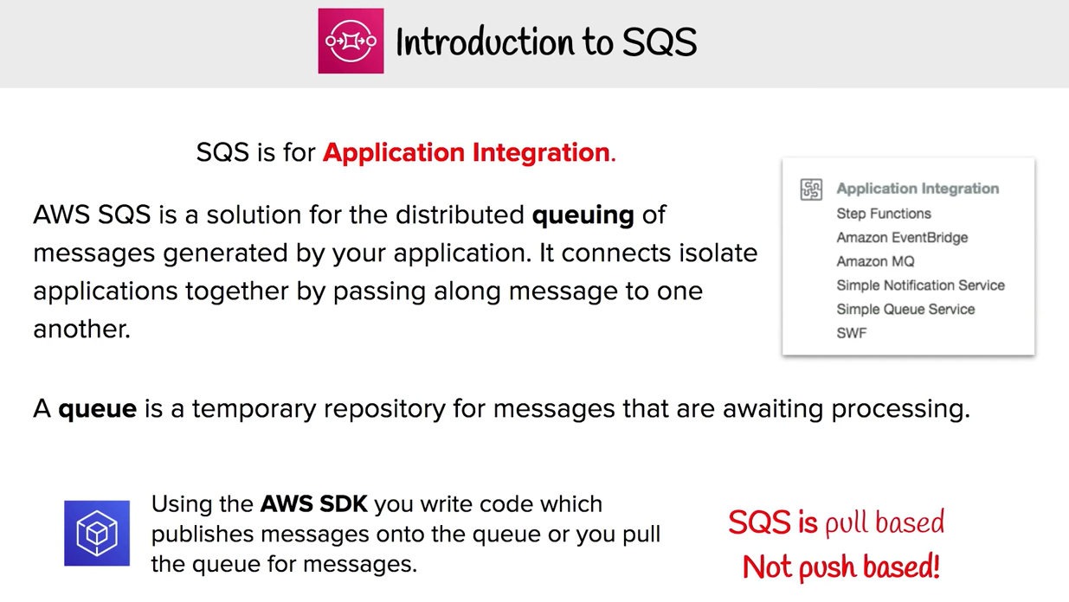

Slide 12
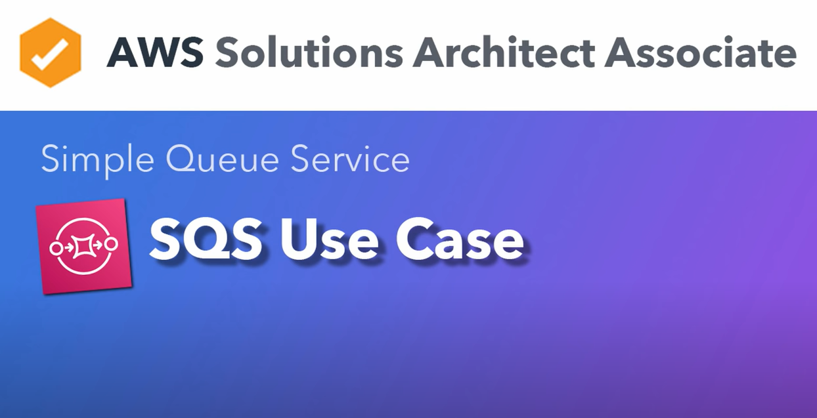

Slide 13
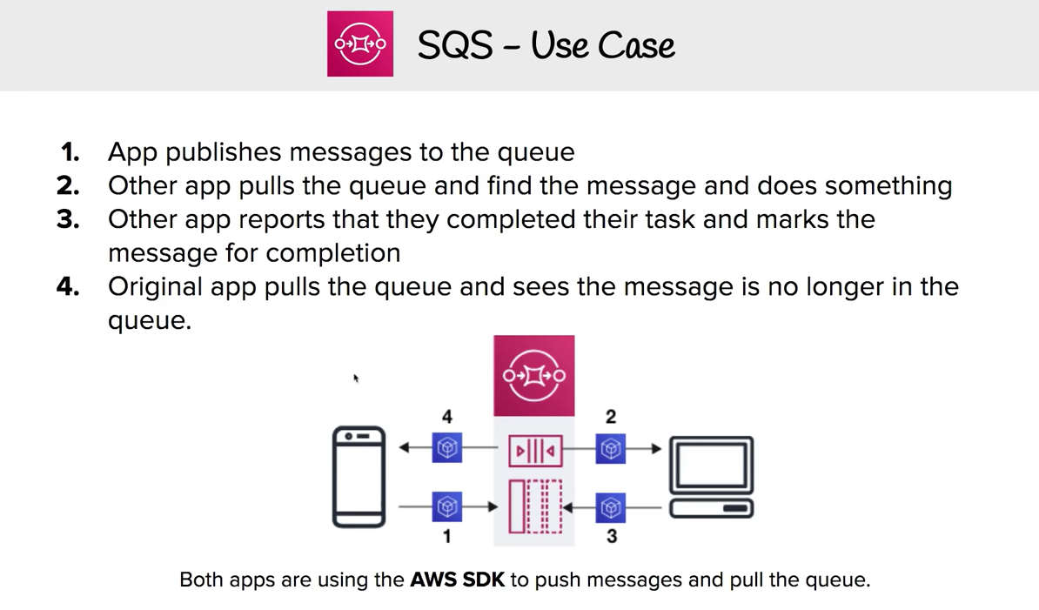

Slide 14
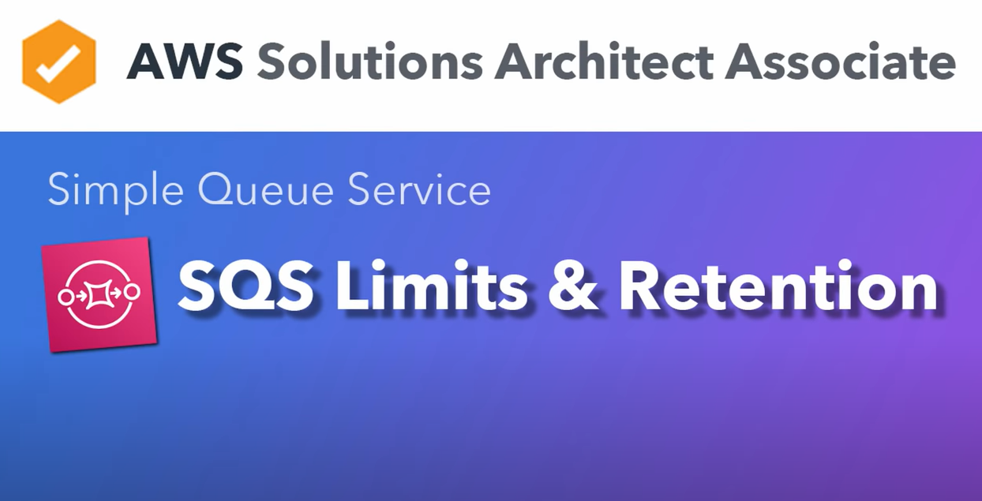

Slide 15
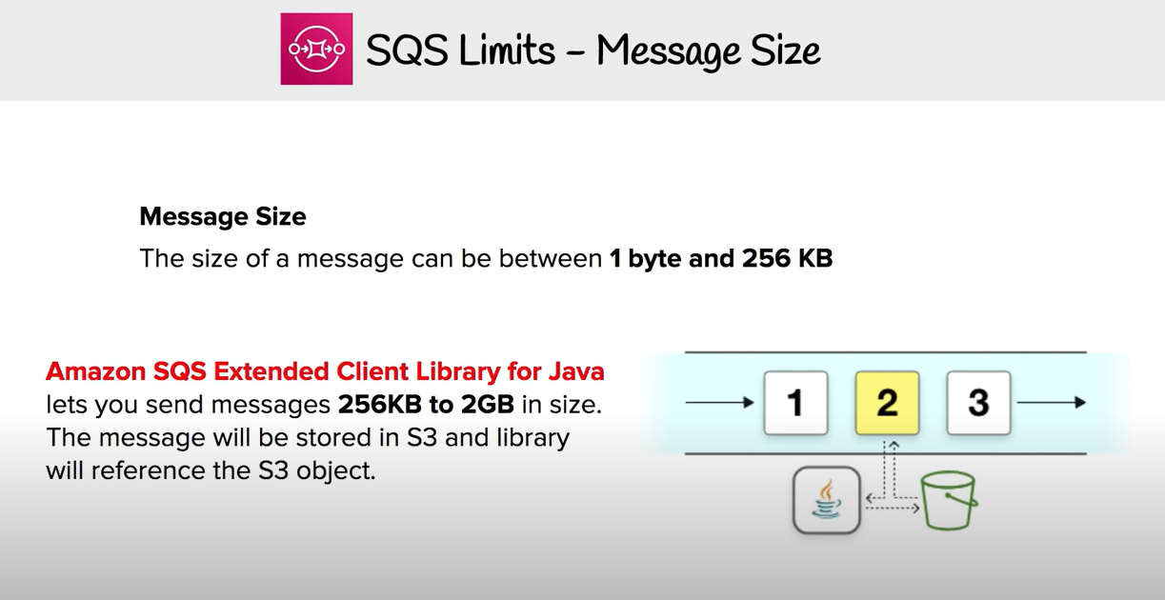

Slide 16
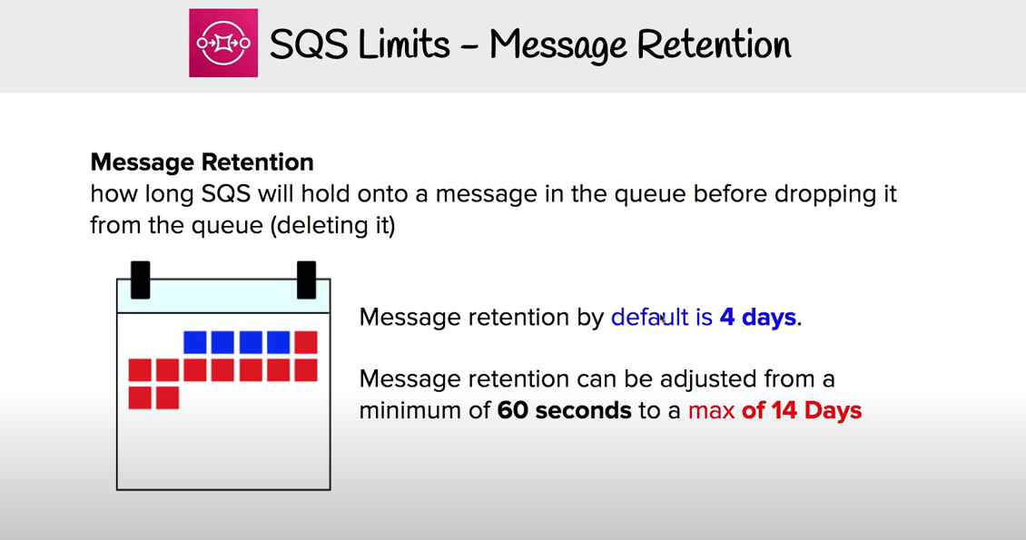

Slide 17
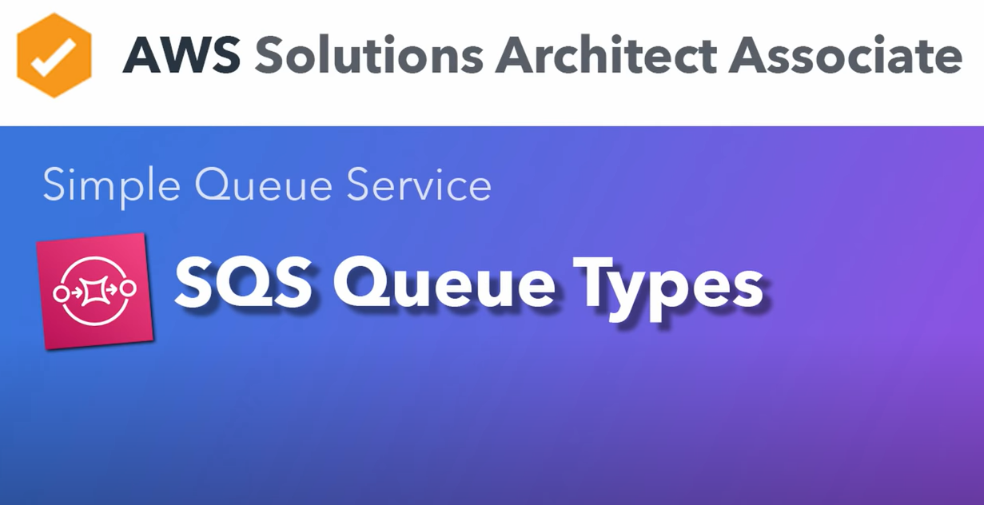

Slide 18
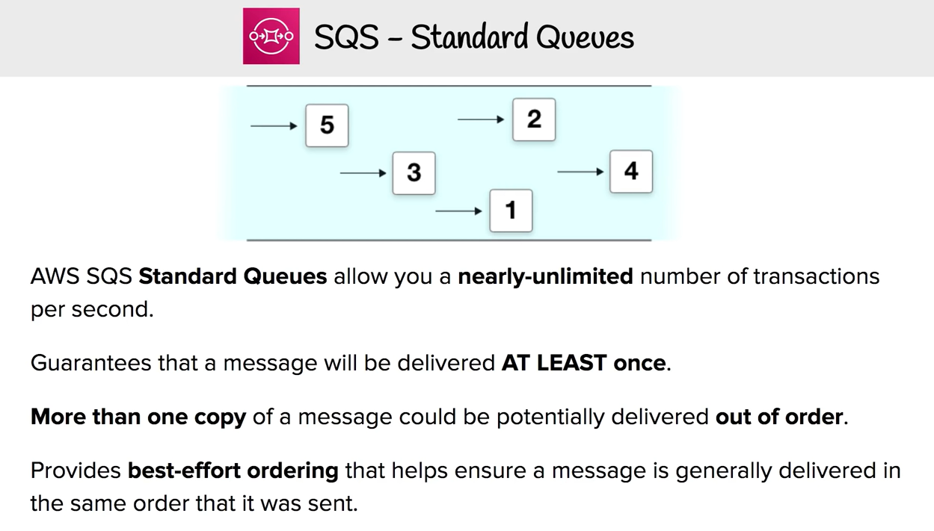

Slide 19
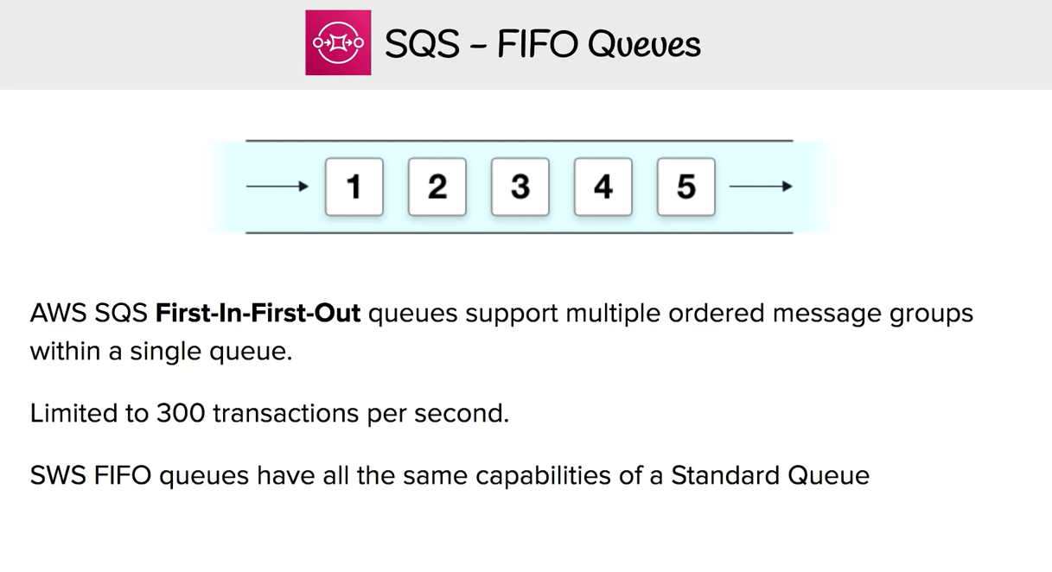

Slide 20
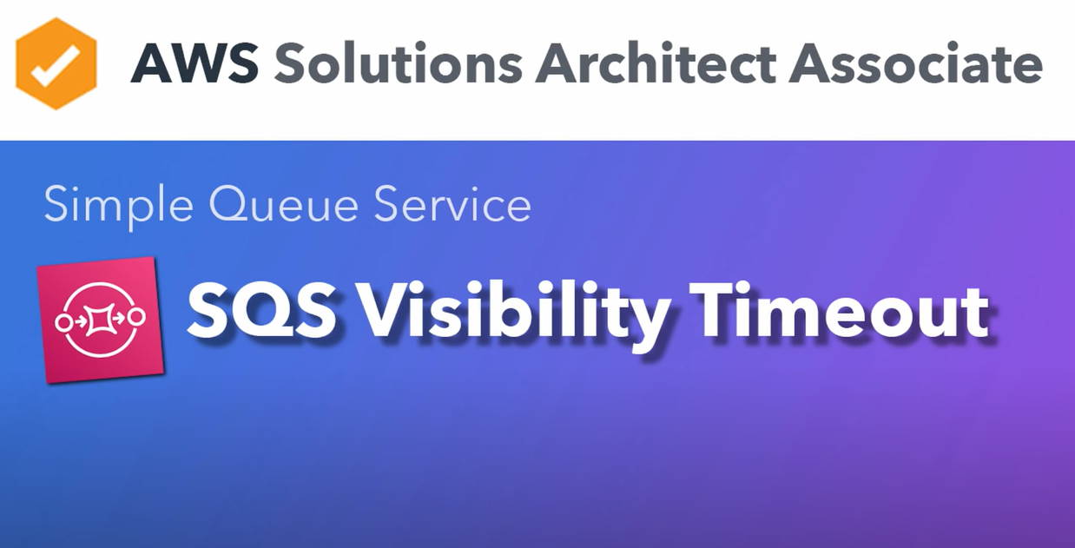

Slide 21
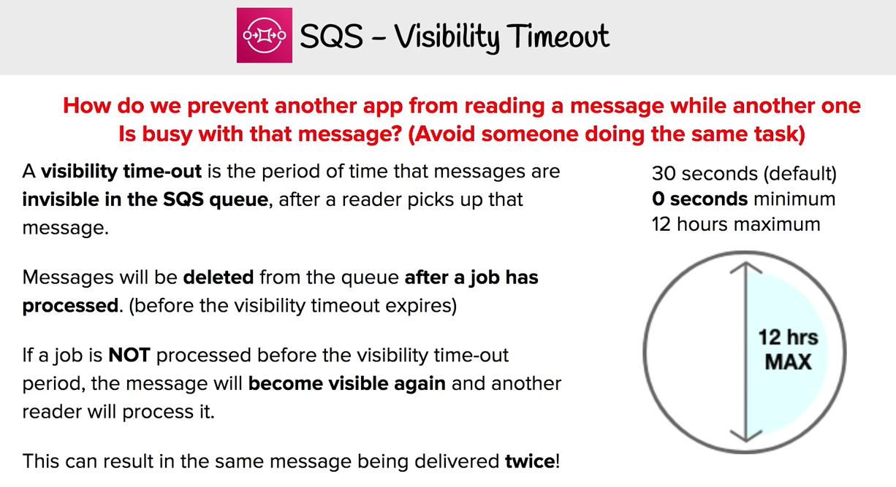

Slide 22
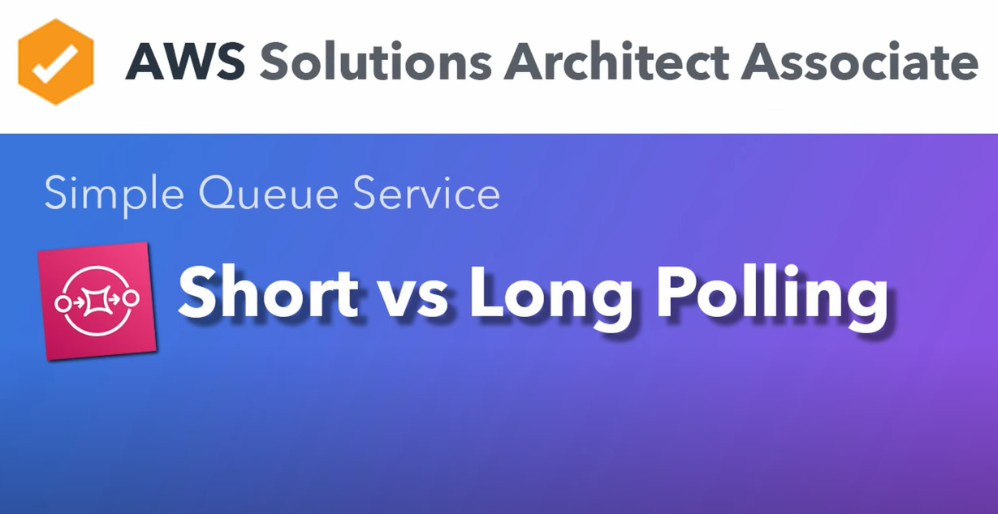

Slide 23
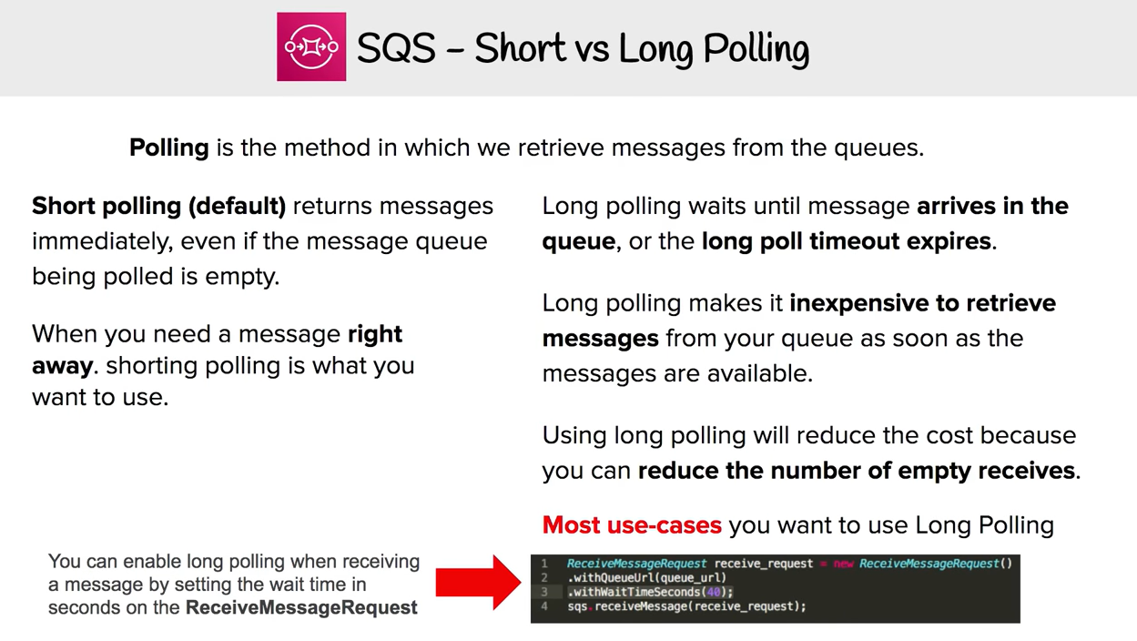

Slide 24
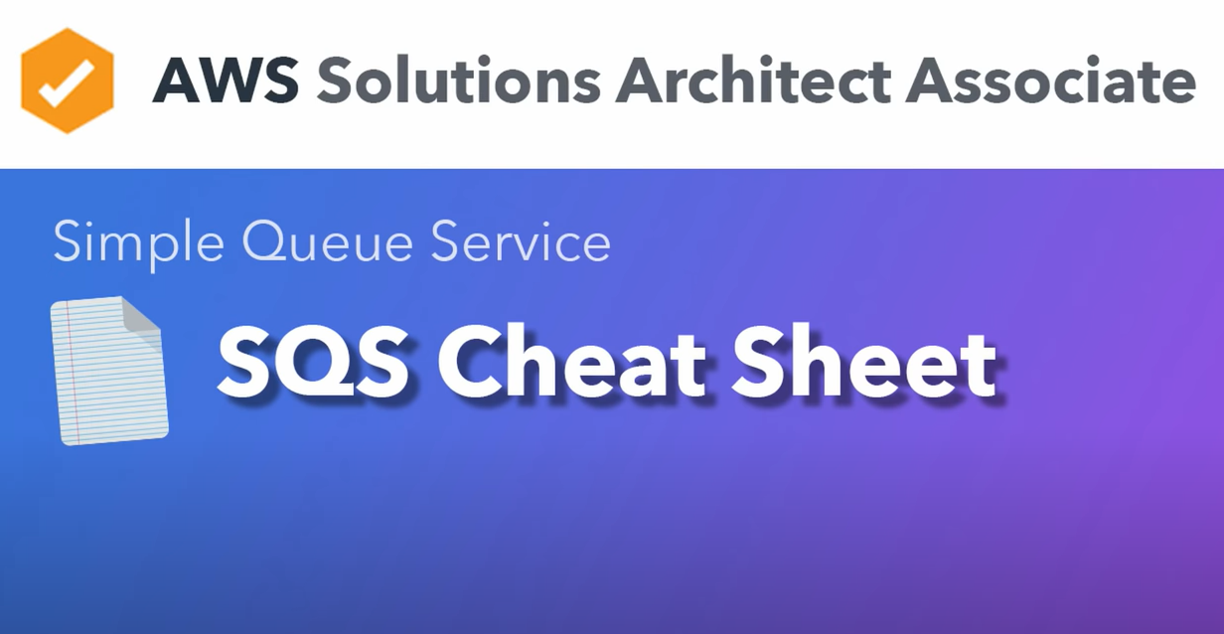

Slide 25
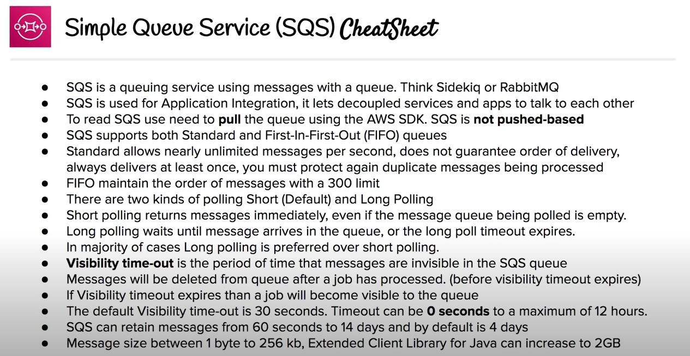

Slide 26
Topics
AWS application services
Roles of application services in AWS architecture
Amazon Simple Queue Service (SQS)
Amazon Simple Notification Service (SNS)
Amazon Simple Workflow Service (SWF)
Amazon Simple Email Service (SES) – beta
Amazon CloudSearch - beta

Slide 27


Slide 28
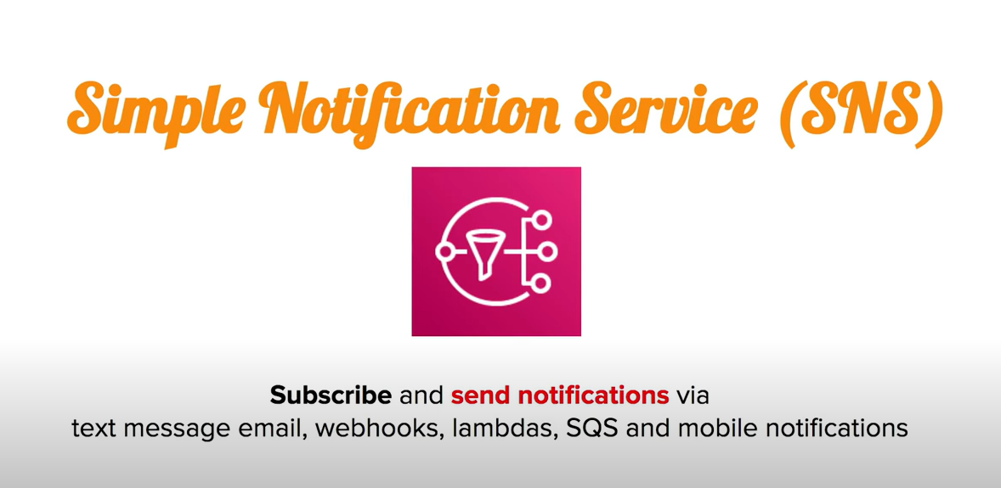

Slide 29
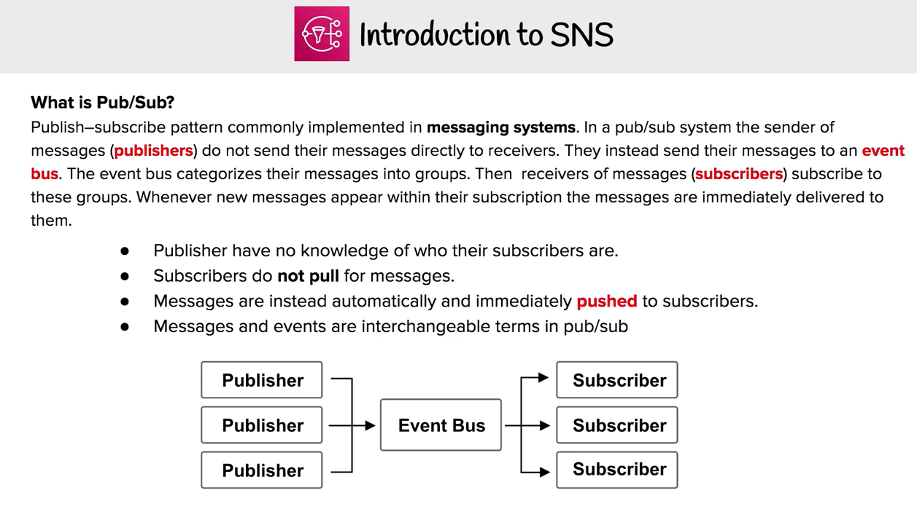

Slide 30
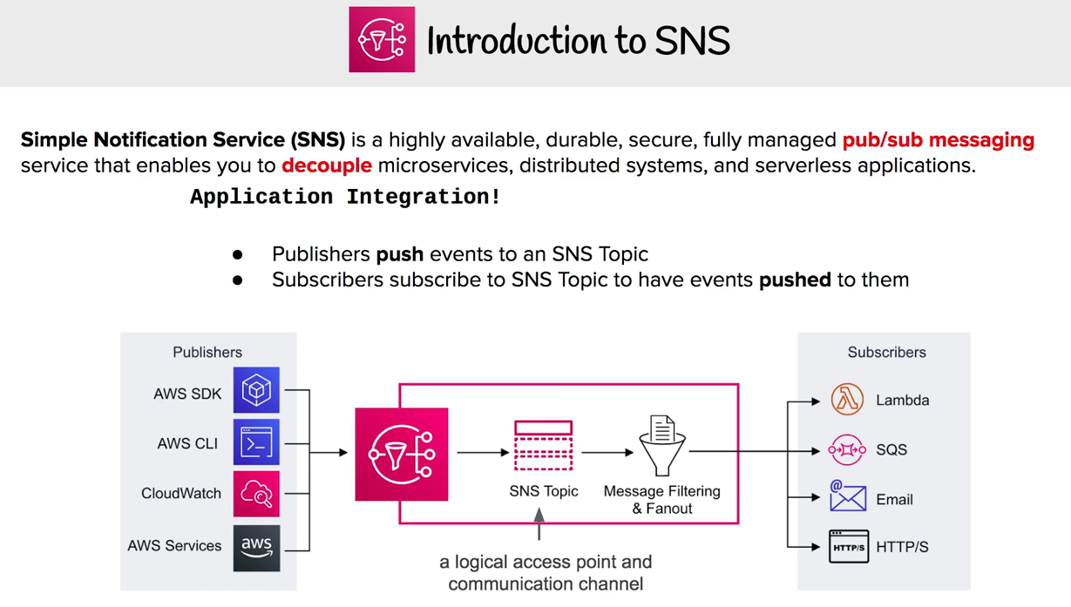

Slide 31
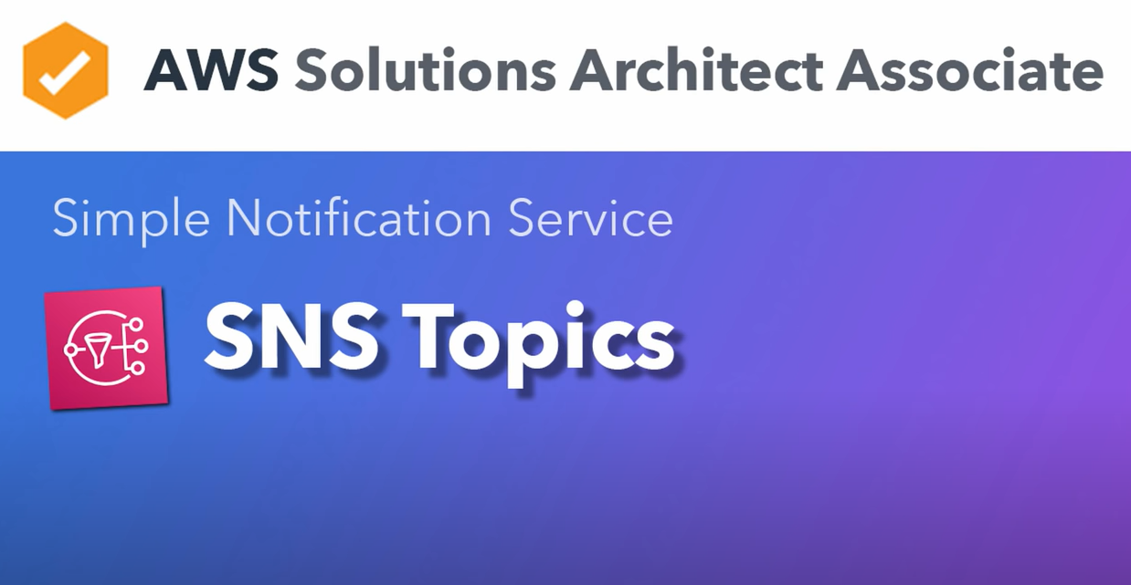

Slide 32
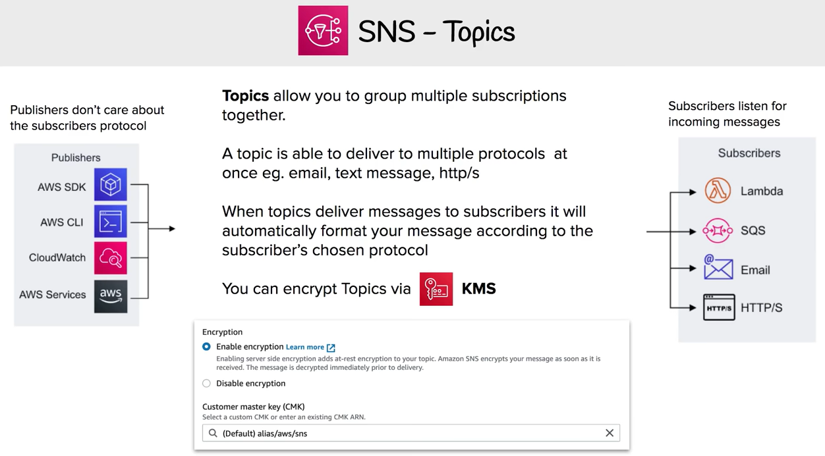

Slide 33
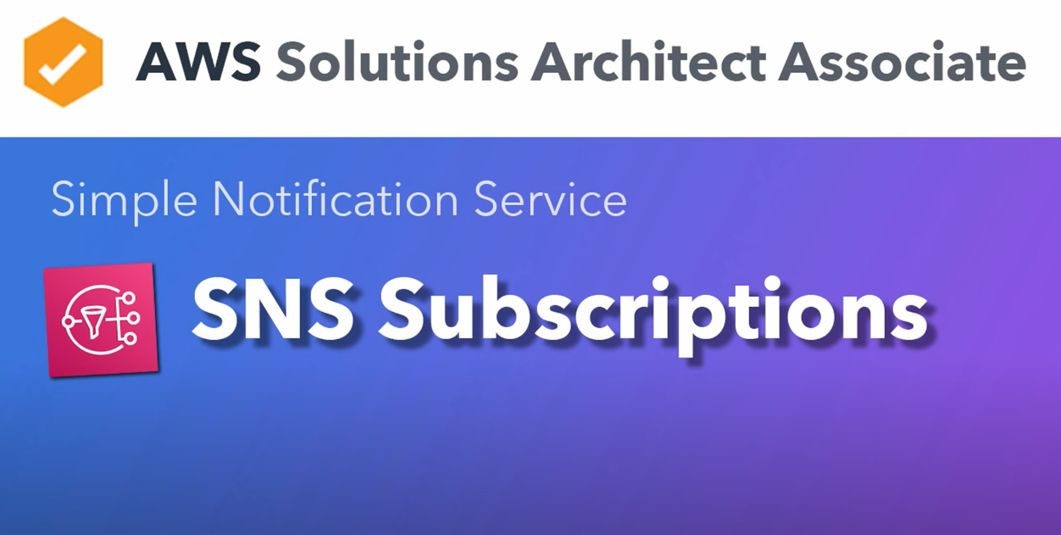

Slide 34
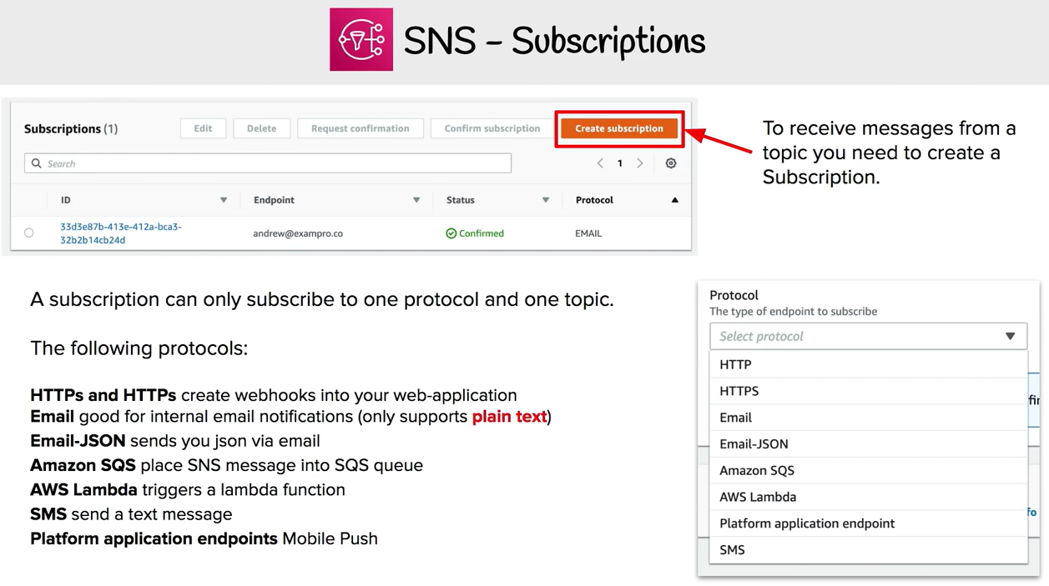

Slide 35
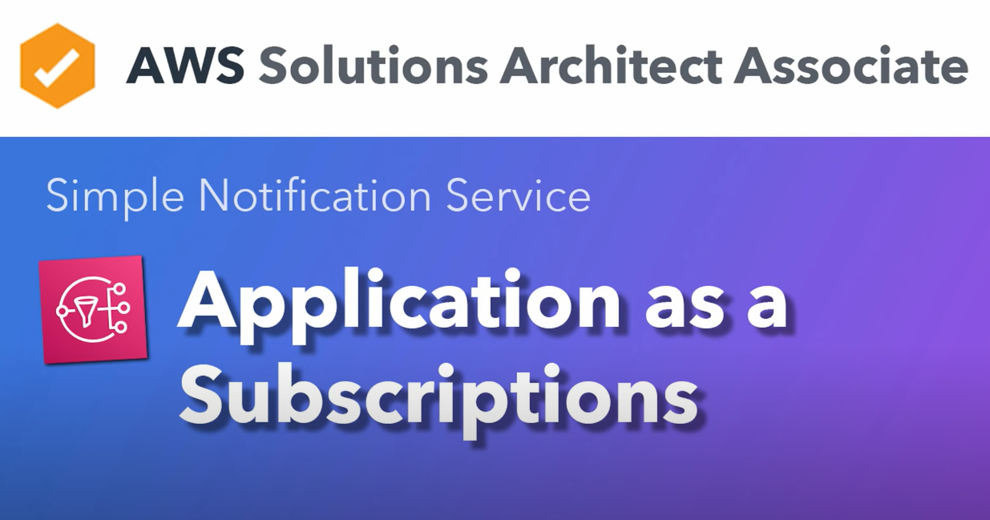

Slide 36
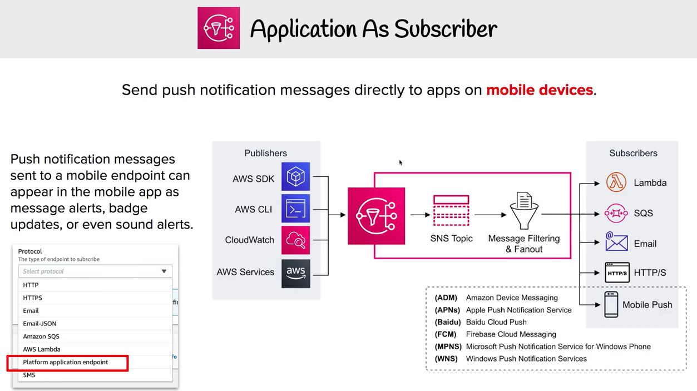

Slide 37
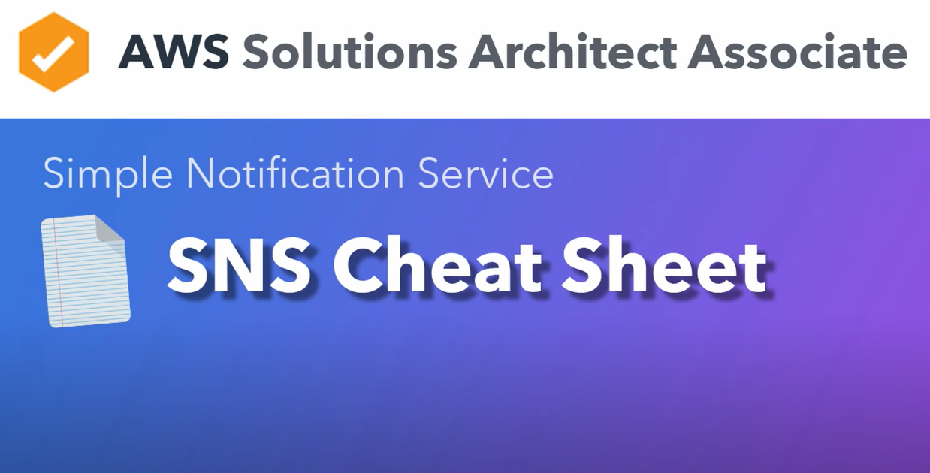

Slide 38
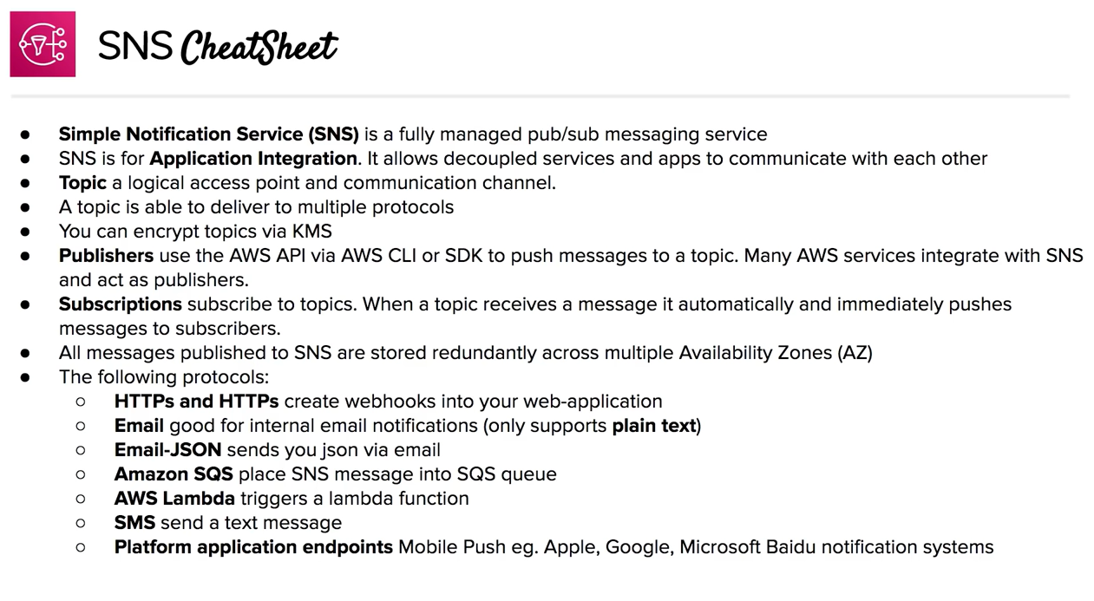

Slide 39
Topics
AWS application services
Roles of application services in AWS architecture
Amazon Simple Queue Service (SQS)
Amazon Simple Notification Service (SNS)
Amazon Simple Workflow Service (SWF)
Amazon Simple Email Service (SES) – beta
Amazon CloudSearch - beta

Slide 40
Amazon Simple Workflow Service (SWF)
Manage workflows, including state, decisions, executions, tasks and logging
Coordinate processing steps across distributed systems
Ensure tasks are executed reliably, in order, and without duplication
HTTP API: executed from code written in any language
Use from any app that supports HTTP, from EC2 to mobile device in a warehouse

Slide 41
Amazon SWF: Decider and Activity Worker
Decider
Decision logic (i.e., flow control)
Decoupled from application logic
Makes decision based on events assigned by SWF
Activity Worker
Does work assigned by SWF
Work scheduled by Decider
Run anywhere

Slide 42
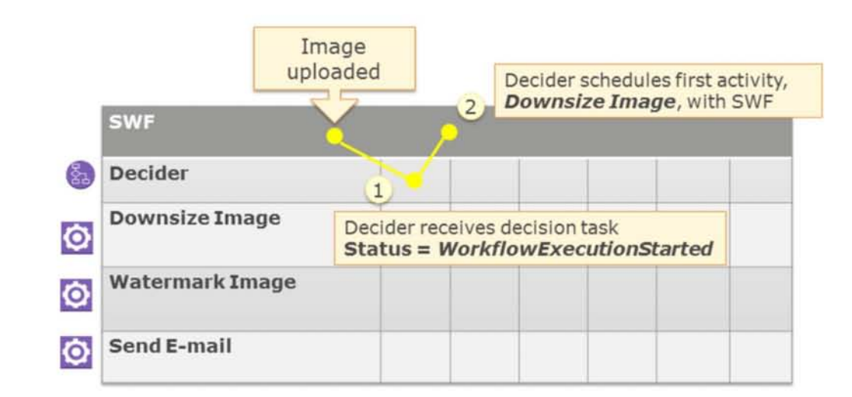
Watermarking application example with SWF (1 of 4)

Slide 43
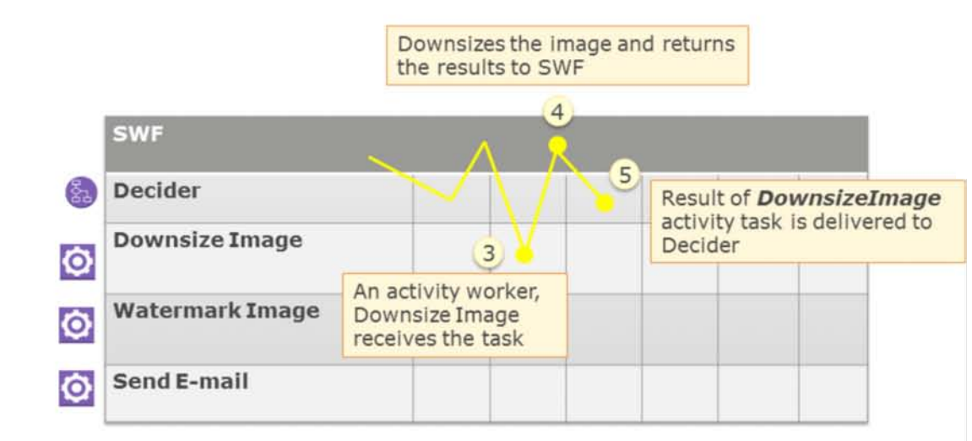
Watermarking application example with SWF (2 of 4)

Slide 44
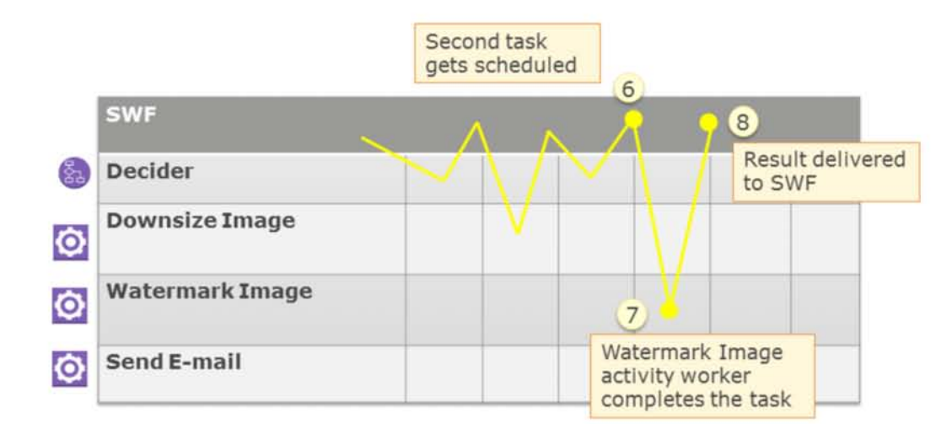
Watermarking application example with SWF (3 of 4)

Slide 45
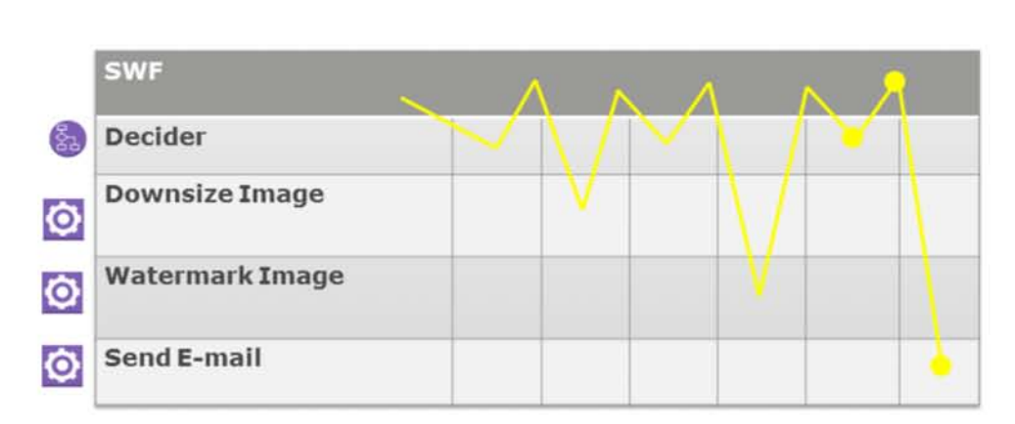
Watermarking application example with SWF (4 of 4)

Slide 46
Topics
AWS application services
Roles of application services in AWS architecture
Amazon Simple Queue Service (SQS)
Amazon Simple Notification Service (SNS)
Amazon Simple Workflow Service (SWF)
Amazon Simple Email Service (SES)
Amazon CloudSearch

Slide 47
Amazon Simple Email Service (SES)
Bulk and transactional email-sending service
Eliminates the hassle of email server management, network configuration, and meeting rigorous Internet Service Provider (ISP) standards
Provides a built-in feedback loop, which includes notifications of bounce backs, failed and successful delivery attempts, and spam complaints

Slide 48
Topics
AWS application services
Roles of application services in AWS architecture
Amazon Simple Queue Service (SQS)
Amazon Simple Notification Service (SNS)
Amazon Simple Workflow Service (SWF)
Amazon Simple Email Service (SES)
Amazon CloudSearch

Slide 49
Amazon CloudSearch
Fully-managed search service
Integrate fast and highly scalable search functionality into applications
Scales automatically: with increases in searchable data or as query rate changes
You can assign weights to selected fields for customized relevance ranking
AWS manages hardware provisioning, data partitioning, and software patches
Supports 33 languages and popular search features such as highlighting, autocomplete, and geospatial search

Slide 50
Module review
List the five main AWS application services
What role does SQS play in designing loosely-coupled systems?
What subscriber types does SNS support?
What are the two components of SWF?

